Slide 1
Lifestage-Specific Considerations in Susceptibility
Melissa Runge-Morris, MD
Institute of Environmental Health Sciences
Wayne State University

Slide 2
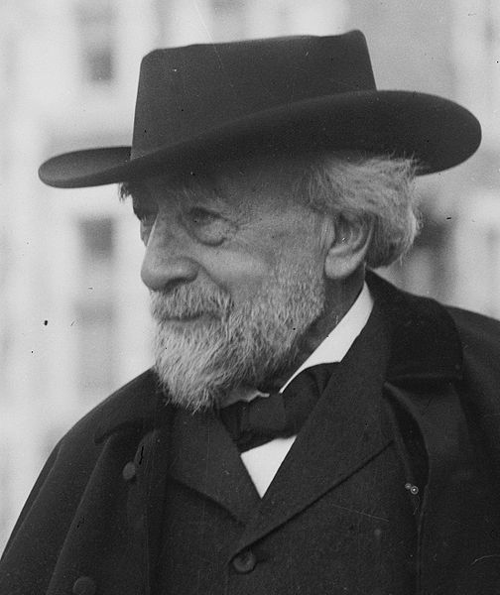
Developmental Pharmacology
Why study ontogeny of enzymes impacting drug and toxicant disposition?
Limited early studies suggested age-specific DME expression differences
“Pediatrics does not deal with miniature men and women, with reduced doses and the same class of disease in smaller bodies, but has its own independent range and horizon,…” — Dr. Abraham Jacobi 1889
Children ≠ Small Adults
Disparities in expression impact age-dependent sensitivity to drugs and environmental toxicants
Therapeutic misadventures

Slide 3
Therapeutic Misadventures
Chloramphenicol dosing in neonates based on extrapolating adult data – Grey Baby Syndrome
Ontogeny of glucuronidation pathway for drug elimination delayed until several weeks after birth
Weiss et al. (1960). Chloramphenicol in the newborn infant: a physiological explanation of its toxicity when given in excessive doses. N Engl J Med 262, 787−794.
Benzyl alcohol as preservative in IV fluids – Gasping Syndrome
Glycine N-acetyltransferase deficiency in premature infants
Gerhanik J (1982) The gasping syndrome and benzyl alcohol poisoning, NEJM 307:1384-88.
Cisapride as a gastric prokinetic agent

Slide 4
Nor-cisapride
CYP3A4
CYP3A7
Long QT
& Ventricular
Arrhythmia
Cisapride
CYP3A4
CYP3A7
2-Hydroxy cisapride

Slide 5
Stevens et al. JPET 307:573-82, 2003

Slide 6
Human Liver Sample Demographics (n=240)
Notes:
75 samples were from fetuses with a median GA of 16 wks. 165 samples were postnatal with a median age of about 4 months, but ranging from 1 day to 18 yrs.
The median time between death and sample processing was 17 hours, ranging from 1 to 41.
For most of the samples gender and ethnic group was known. About 57% of samples were male, 35% female. Just under 39% were caucasian, about 37% were african american and 8% hispanic.

Slide 7
Quantifying Enzyme Levels/Activity

Slide 8
Human DME Ontogeny
Hines, Pharmacol Therap 118:250-267, 2008

Slide 9
Human Hepatic DME Ontogeny
Hines, Handbook of drug metabolism, 2nd Edition, Vol 183, Chapter 9, pp. 227-242, Informa Healthcare, New York, NY, 2008

Slide 10
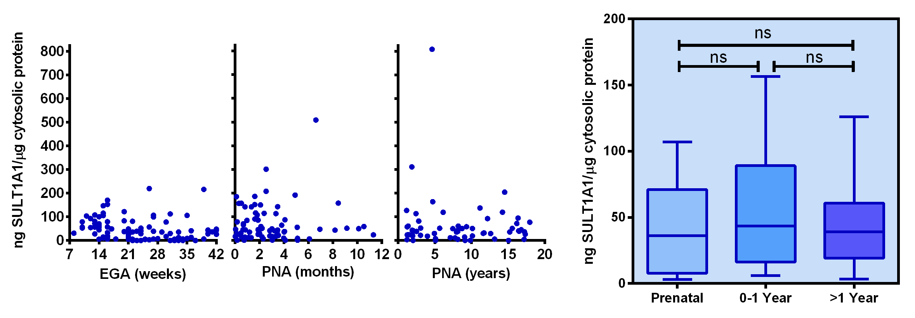
Human SULT Ontogeny (SULT1A1)
SULT1A1
Stds
Samples
Duanmu et al., J Pharmacol Exp Ther 316:1310-1317, 2006

Slide 11
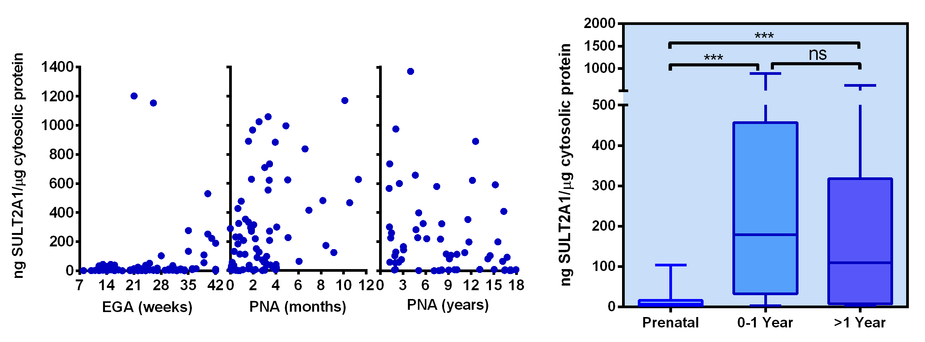
Human SULT Ontogeny (SULT2A1)
SULT2A1
Stds
Samples
Duanmu et al., J Pharmacol Exp Ther 316:1310-1317, 2006

Slide 12
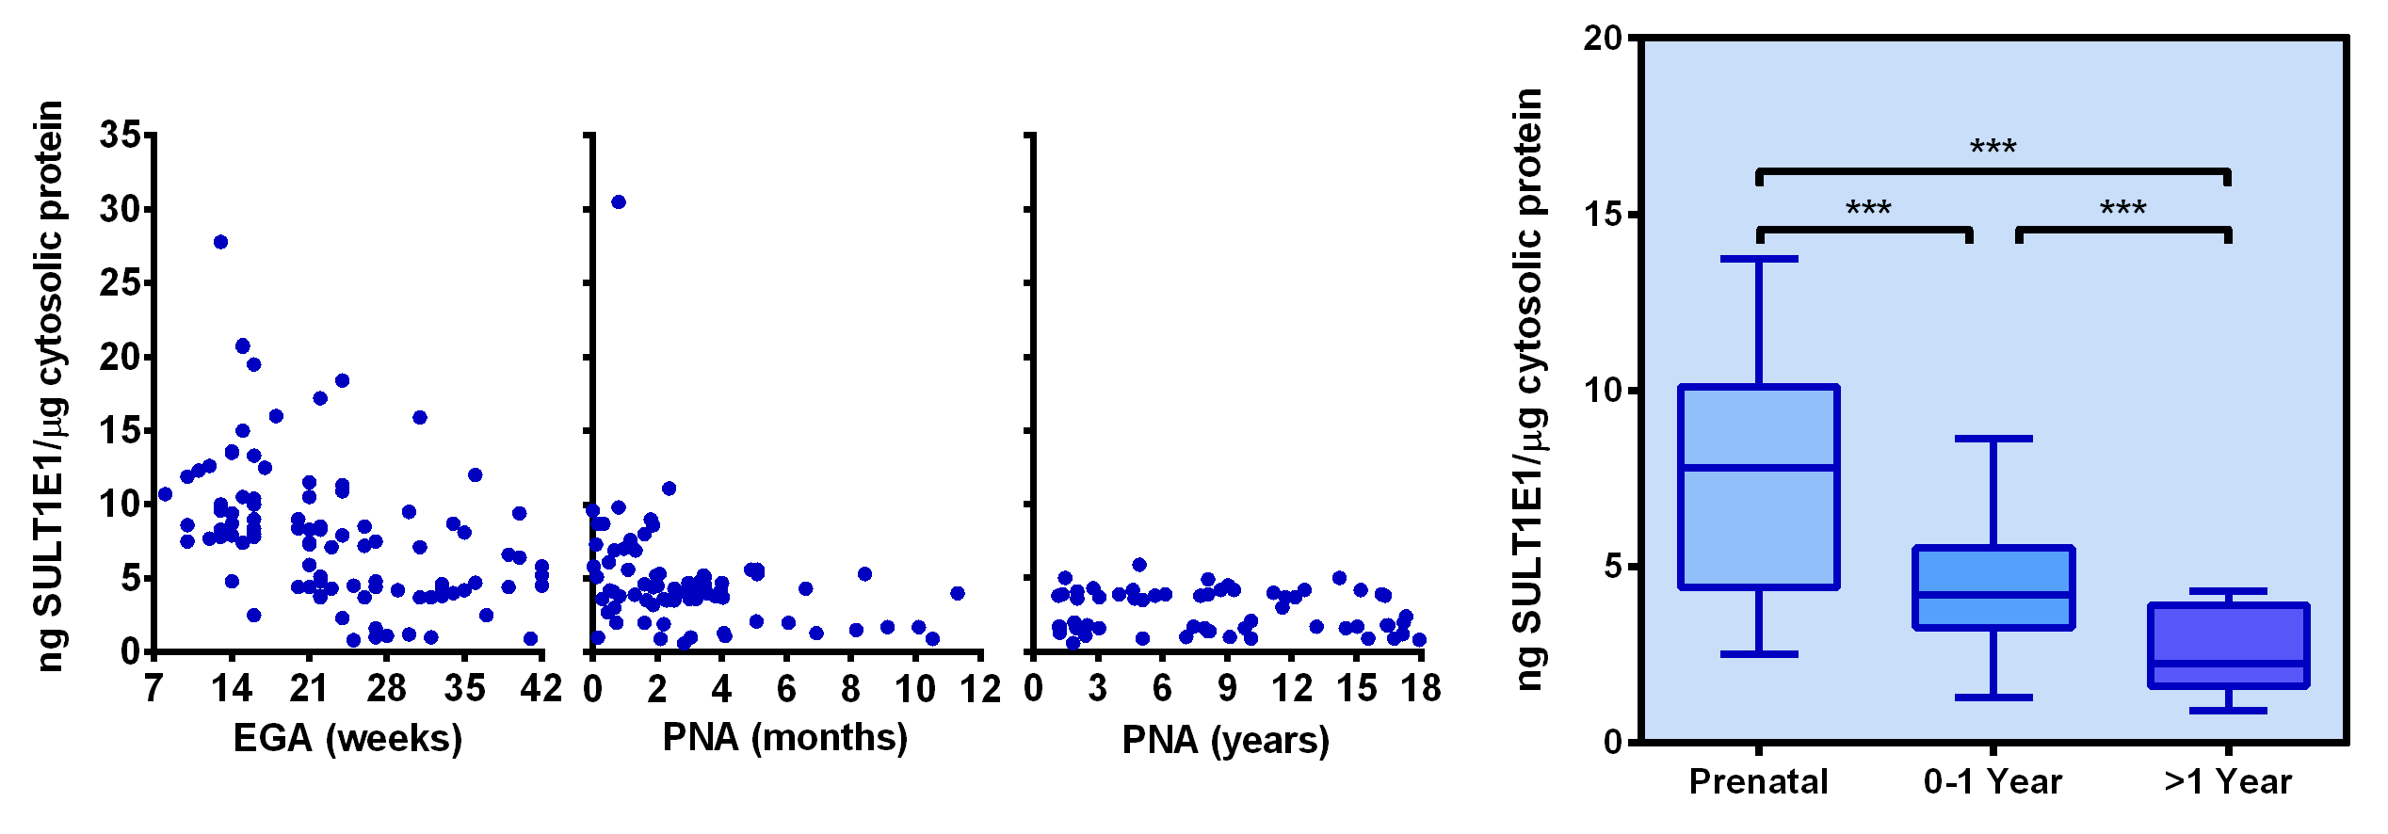
Human SULT Ontogeny (SULT1E1)
SULT1E1
Stds
Samples
Duanmu et al., J Pharmacol Exp Ther 316:1310-1317, 2006

Slide 13
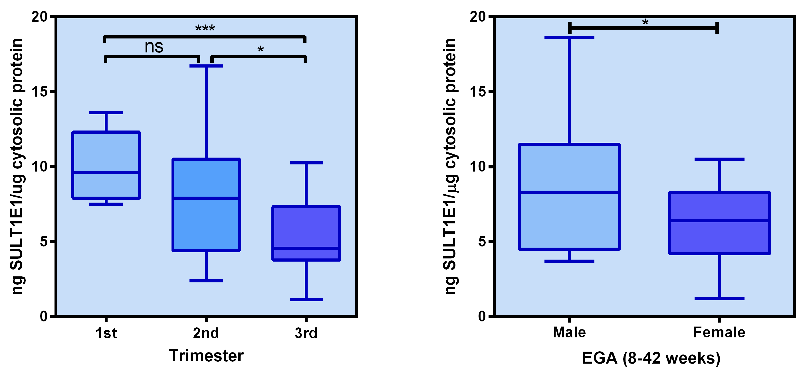
Human SULT Ontogeny (SULT1E1)
Duanmu et al., J Pharmacol Exp Ther 316:1310-1317, 2006

Slide 14
CYP2C9 Ontogeny
Koukouritaki et al. J. Pharmacol. Exptl. Ther. 308:965-974, 2004

Slide 15
CYP2C9 Ontogeny
Koukouritaki et al. J. Pharmacol. Exptl. Ther. 308:965-974, 2004

Slide 16
FMO3 Metabolism of Trimethylamine

Slide 17
FMO3 Hepatic Ontogeny
Koukouritaki et al. Pediatr Res 51:236-243, 2002

Slide 18
Transient Trimethylaminuria in Childhood
Two case reports by Mayatepek & Kohlmüller (Acta Paediatr 87:1205-7, 1998)
Patient
Age
%TMA / %TMAO
1
2 mo
0.148
1
6 mo
0.065
2
4 yr
0.241
2
5 yr
0.014
TMAU Patients
0.852 to 9.000 (3.000)*
Control Patients
0.002 to 0.099 (0.045)*
* Data from Mitchell & Smith, Drug Metab Disp 29:517-21, 2001

Slide 19
GSTZ1 Ontogeny
Li et al. Drug Metab Disp 40:232-239, 2011

Slide 20
GSTZ1 Ontogeny
Li et al. Drug Metab Disp 40:232-239, 2011

Slide 21
Age-Dependent Changes in Liver Weight
to Body Weight Ratio

Slide 22
GSTZ1 Ontogeny
Li et al. Drug Metab Disp 40:232-239, 2011

Slide 23
Summary
Human hepatic drug metabolizing enzyme ontogeny can be categorized into three classes based on expression patterns
Common regulatory mechanisms?
Requirement for maturation into expected (adult) genotype/phenotype relationships
Age can trump genotype!
Differences in other physiological factors have significant effects
liver mass:body surface
GFR

Slide 24
Summary
Window of hypervariability common for class 1 and class 3 enzymes
Perinatal period, but differs among enzymes
Hypervariability clearly linked to interindividual differences in the regulation of ontogeny
Mechanisms regulating ontogeny may be different than those regulating adult constitutive or inducible expression
Data incorporated into physiologically-based pharmacokinetic (PBPK) modeling software allowing age-dependent prediction of pediatric drug disposition

Slide 25
Acknowledgments
Medical College of Wisconsin
Ronald Hines, PhD (US EPA)
Gail McCarver, MD
Sevasti Koukouritaki, PhD
Wayne State University
Thomas Kocarek, PhD
Zhengbo Duanmu, PhD
University of Alabama at Birmingham
Charles Falany, PhD
Grant Support
NIEHS Grant R01 ES005823
NIEHS Center Grant P30 ES020957
Tissue Bank Support
NICHD N01-HD-8-3283 and N01-HD-8-3284 – Brain and Tissue Bank for Developmental Disorders, U Maryland and U Miami
NICHD HD-00836 – Central Laboratory for Human Embryology, U Washington

